Slide 1




Waiting for the Magic Queue Times for Popular Disney World Attractions
Christopher Carlevato, Deratu Dinku, Ruxin Li, Kevin Schweiss
Database Management 2019
Notes:
Kevin

Slide 2
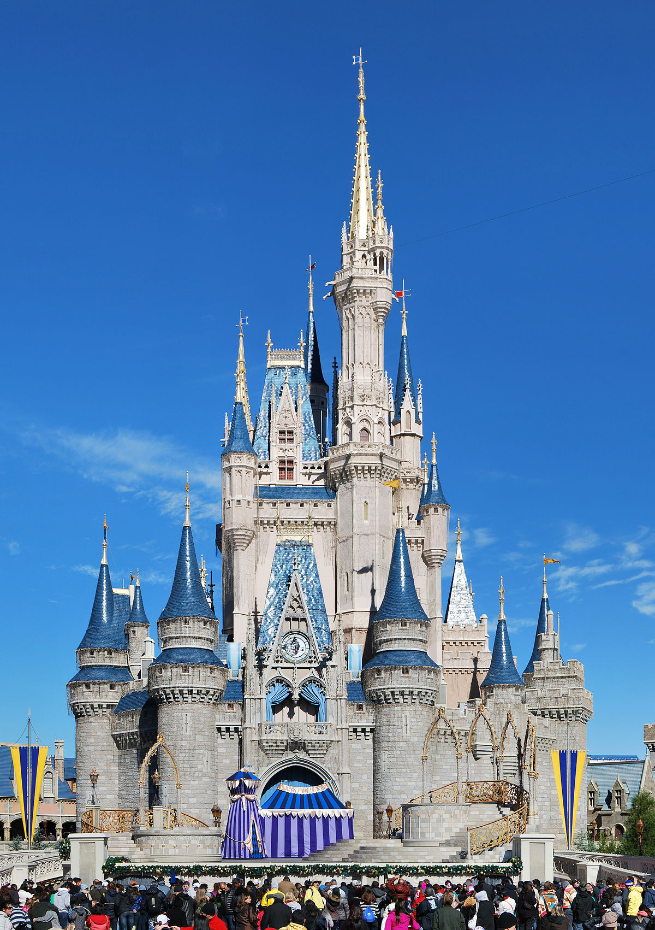

Agenda
1. Business Background
2. Dimensional Model
3. ETL Process and SQL Output
4. Data Analysis
5. Conclusion and Experience
Notes:
Milan

Slide 3
Disney’s Mission Statement
Storytelling
Iconic Brands
Entertain
Inform
Inspire
Innovative Technology
Creative Minds
“I only hope that we never lose sight of one thing… that it was all started by a mouse” – Walt Disney
3
Notes:
Milan
Mission statement – to entertain, inform, inspire through the use of storytelling, iconic brands, creative minds and the use of innovative technology

Slide 4
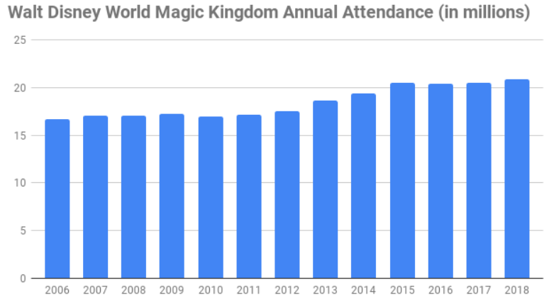
Disney’s Prices and Attendance
https://allears.net/walt-disney-world/wdw-planning/wdw-ticket-increase-guide/
https://disneynews.us/disney-parks-attendance/
4
Notes:
Milan
While Disney ticket prices go up, attendance is still increasing at the Disney World parks.

Slide 5
Data Source
Ride wait times from Touringplans.com
These data run from 2012 to present
Historical queue times for multiple popular attractions across all 4 theme parks
Updated daily
Generates data from Disney and users of their mobile app
Data purpose:
Create crowd calendars
Help customers optimize their vacation
Release an annual publication entitled “The Unofficial Guide to Walt Disney World”
5
Notes:
Milan
Data is from a 3rd party source that has parkgoers track the wait times for the rides they go on. Issue is that not a necessary consistent stream of data as some rides have 10 data points per hour and others have 2
Already used for crowd types but not utilized by Disney

Slide 6
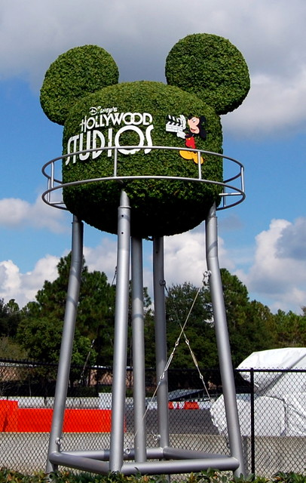
Business Use
Park development projects
Identifies potential rides to close or change
Market trends: preferred ride type
Popularity measures of various attractions
How people are spending their time in the parks
6
Notes:
Milan
We plan on using this for more Disney specific interpretations and how they can use attendance trends to see what to do next in the park

Slide 7
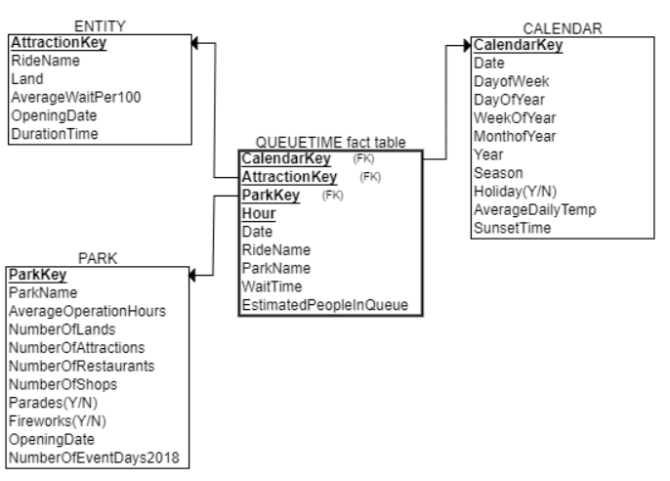
Dimensional Diagram
7
Notes:
Ruxin
ERD diagram built from ERDPlus
The Queue table includes both keys and the names of the rides, parks, and dates for readability of the table. It is an unnecessary addition

Slide 8
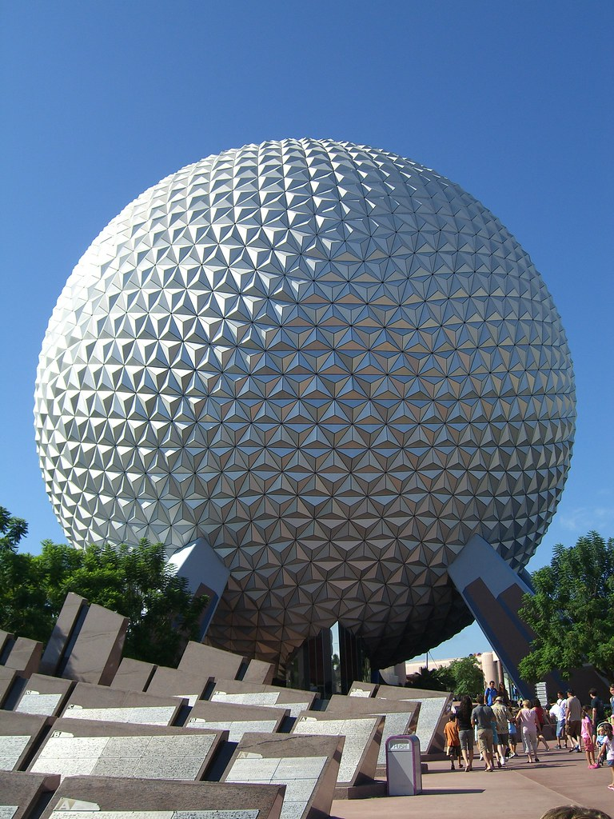
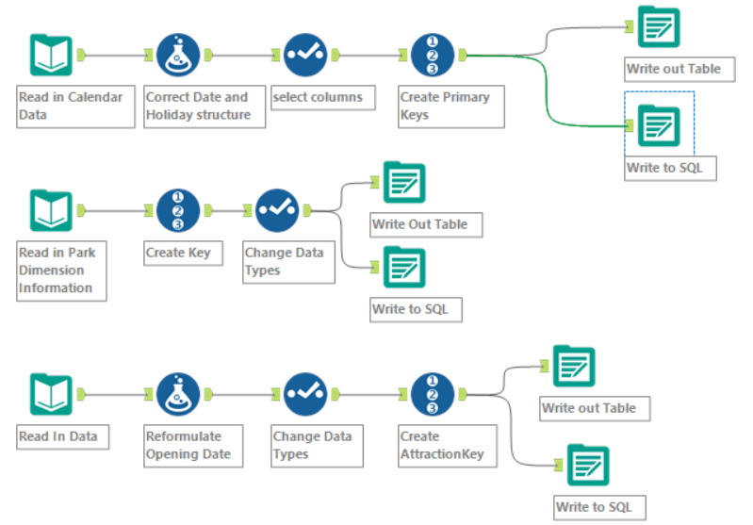
ETL – Dimension Creation
8
Notes:
Ruxin
Alteryx work flow to generate dimensions

Slide 9
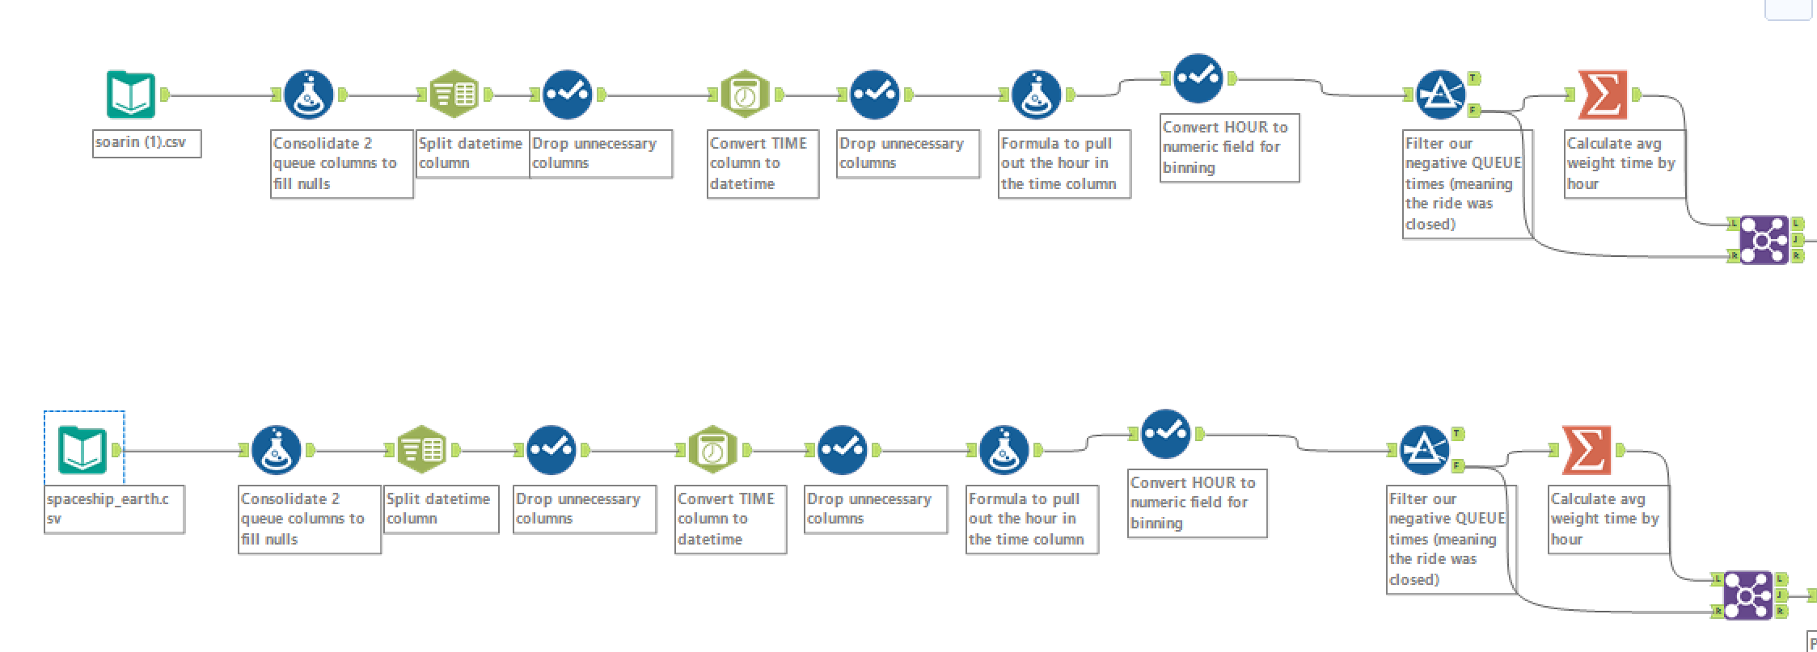
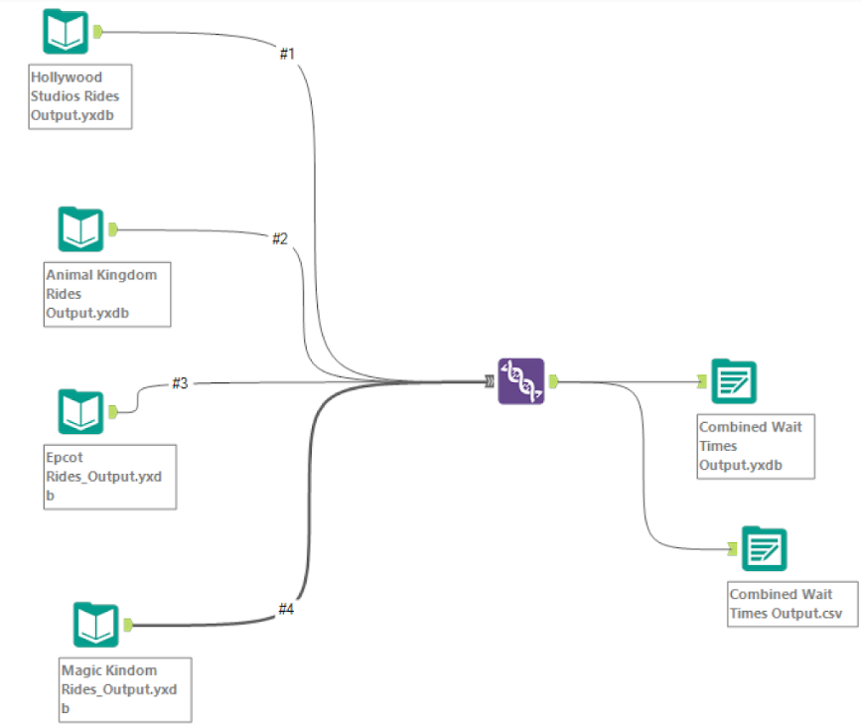
ETL – Queue Data
9
Notes:
Ruxin
Alteryx flow to clean and prepare the wait times for the individual rides per hour of each day that data was put in for

Slide 10
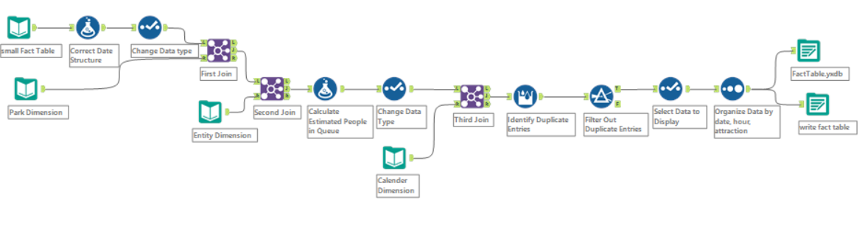
ETL – Fact Table Creation
10
Notes:
Ruxin
Alteryx flow to show how we generate the fact table and connect it to the dimensions

Slide 11
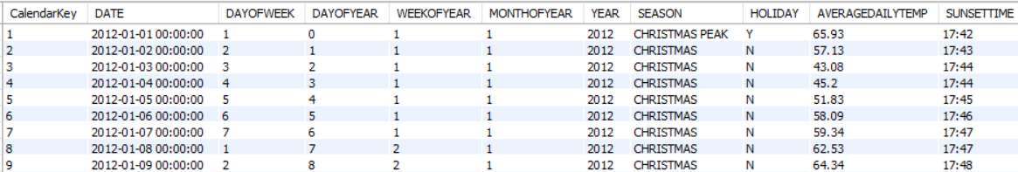
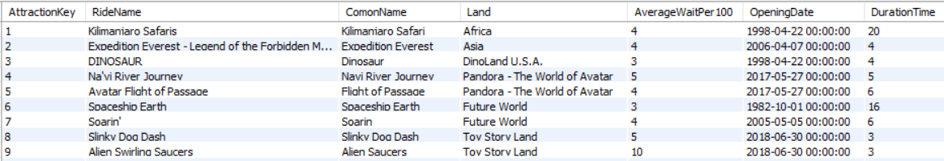
SQL Tables
Calendar Dimension
Attraction – Entity Dimension
11
Notes:
Ruxin
Screenshots of SQL tables after creation

Slide 12
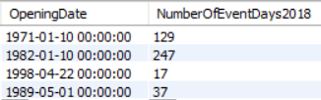
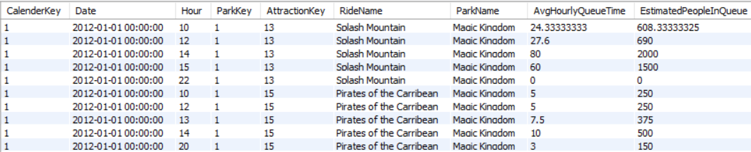
SQL Tables
Park Dimension
Queue Time Fact Table
12
Notes:
Ruxin
Screenshots of SQL tables after creation

Slide 13
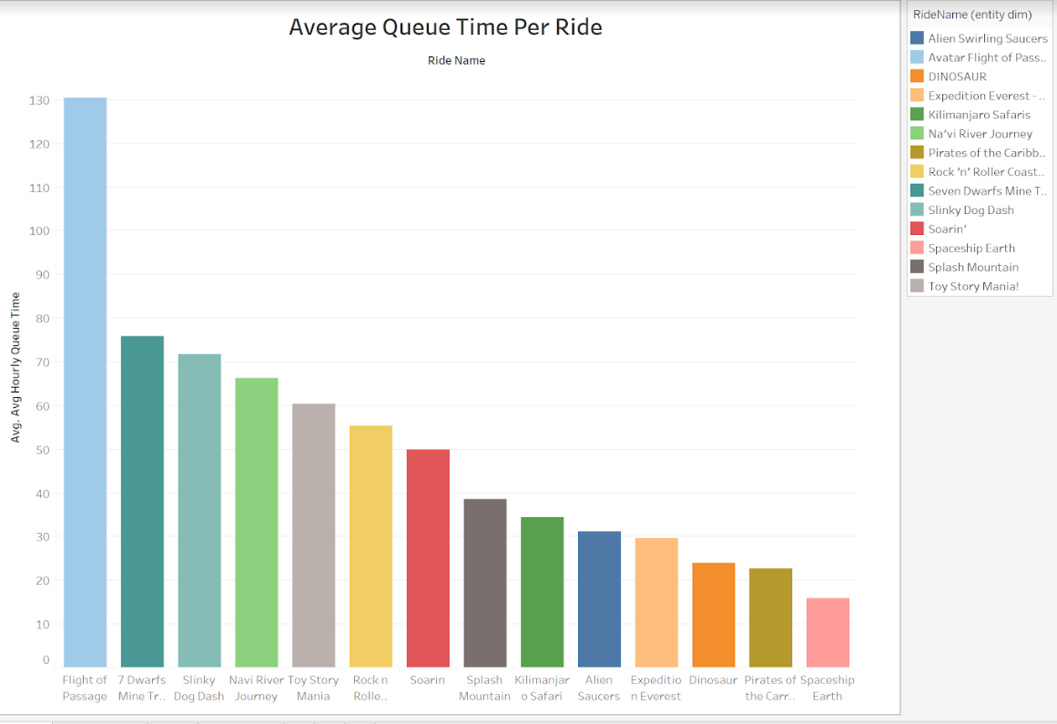
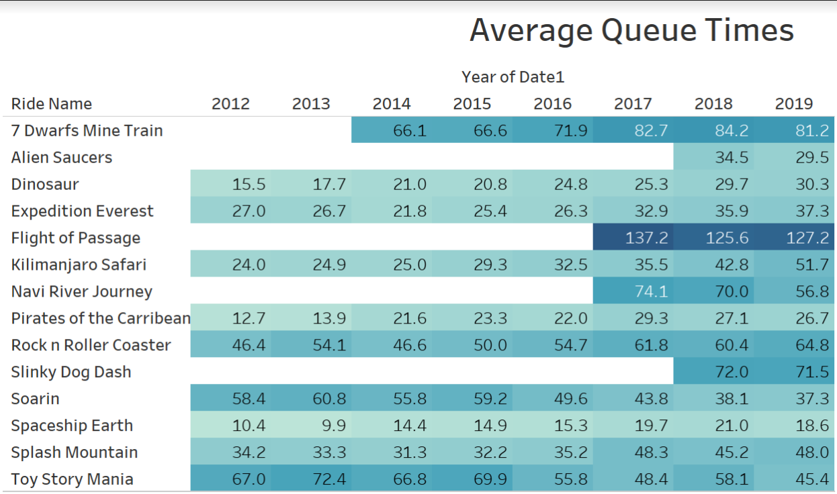
Average Wait per Attraction
13
Notes:
Chris
Wait time averages per each attraction. Chart on the left shows average since either 2012 or since the attraction opened.
Table on right is the annual average wait time. Can see impact of ride openings and trends over time

Slide 14
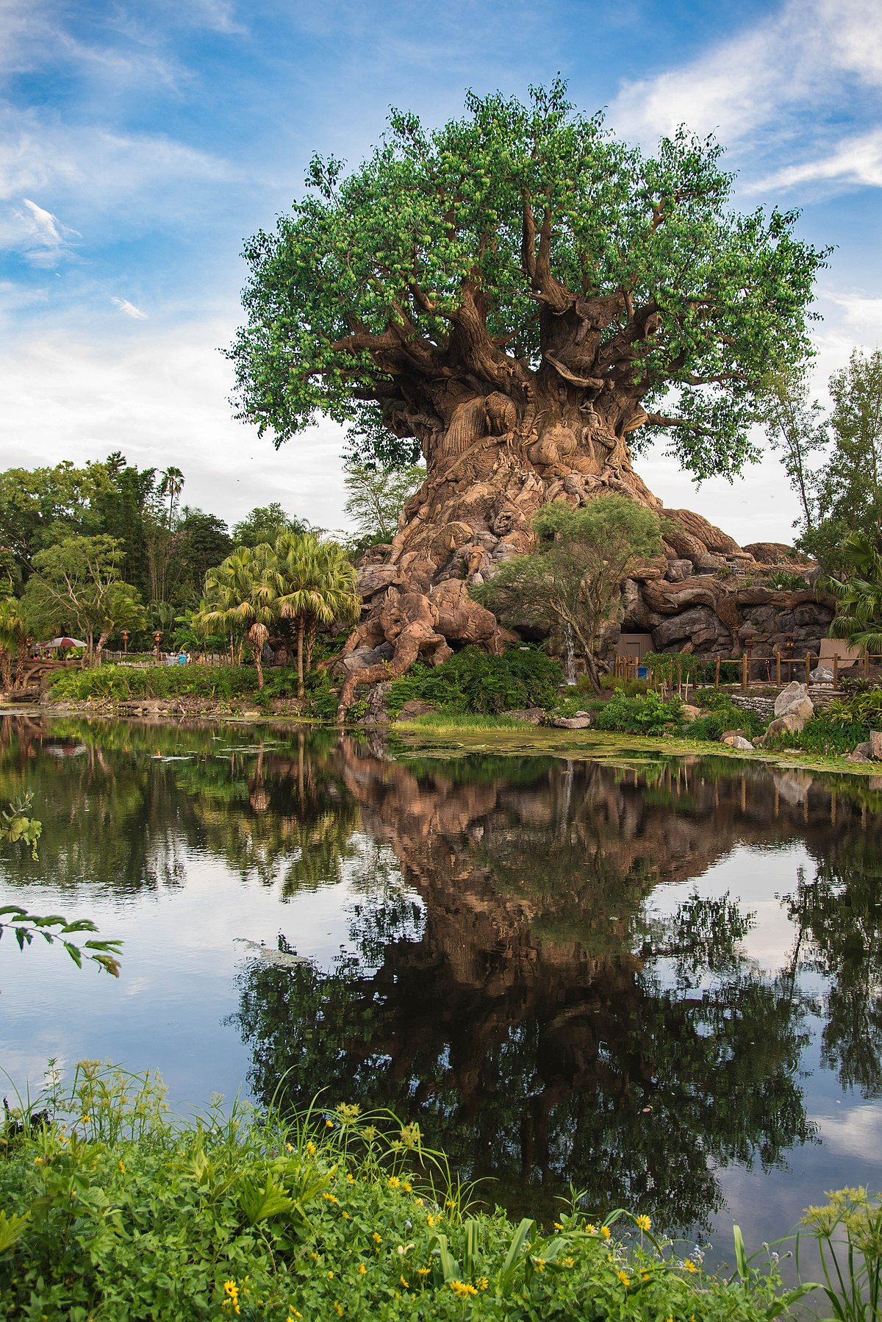
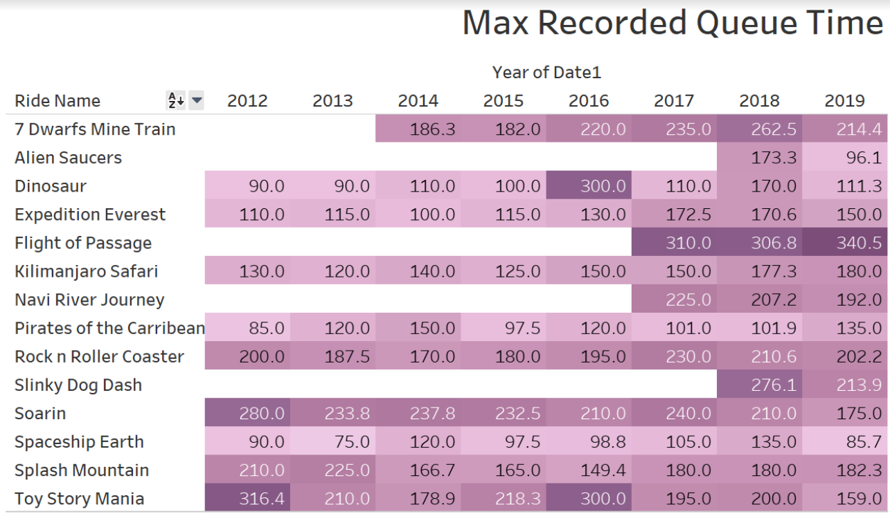
Max Recorded Wait Time
14
Notes:
Chris
Maximum wait times ever recorded through the data source per year. Shows the extremes of the queues

Slide 15
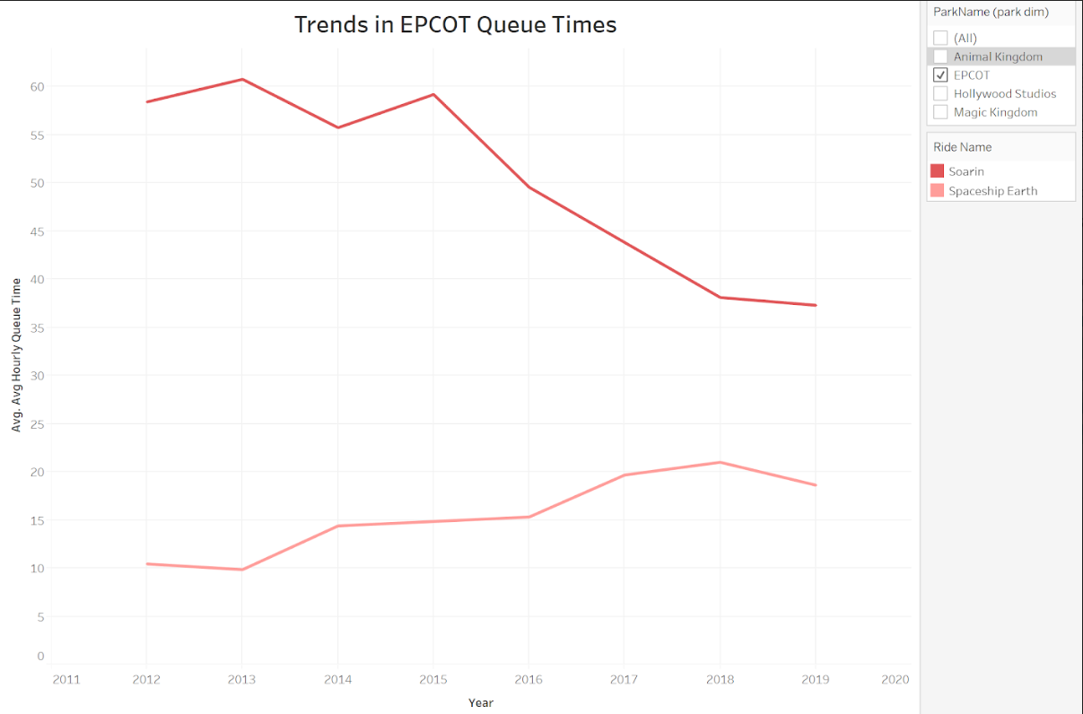
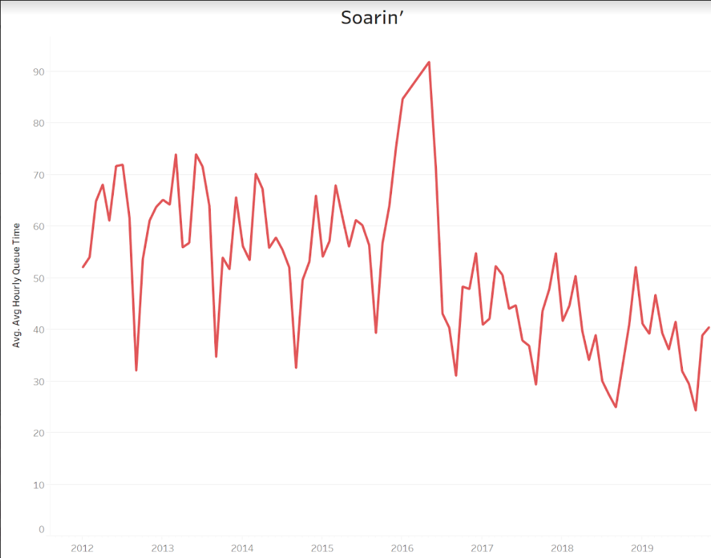
Woes for EPCOT Attractions
Soarin’ Around the World
June 2016
15
Notes:
Chris
Concerns with EPCOT attractions in the data set. Either short, or decreasing queue times which is not the norm when looking at the other Disney attractions. Creates the question if something needs to be done about the rides

Slide 16
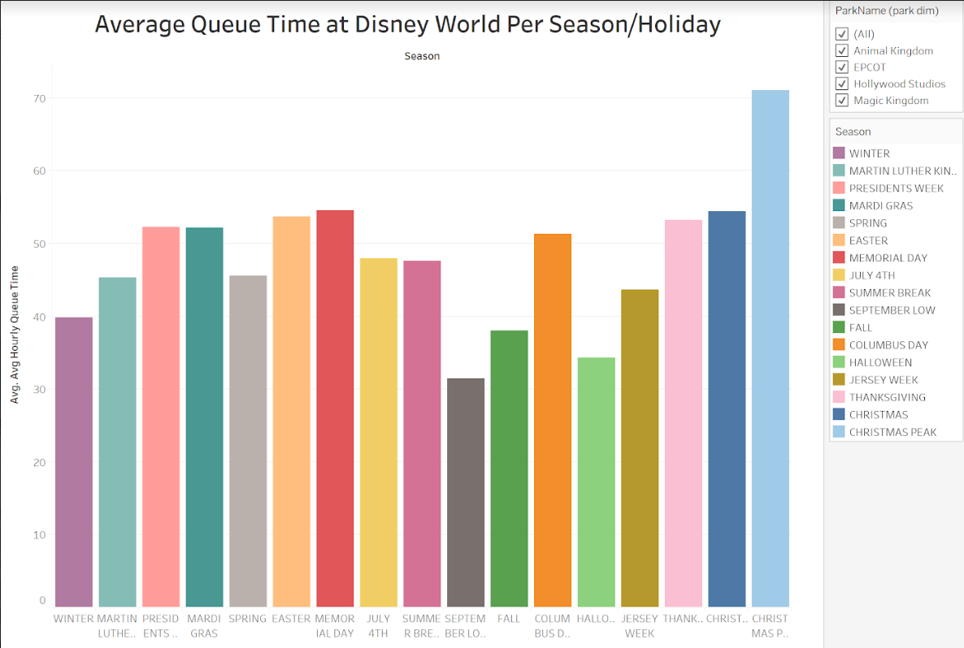
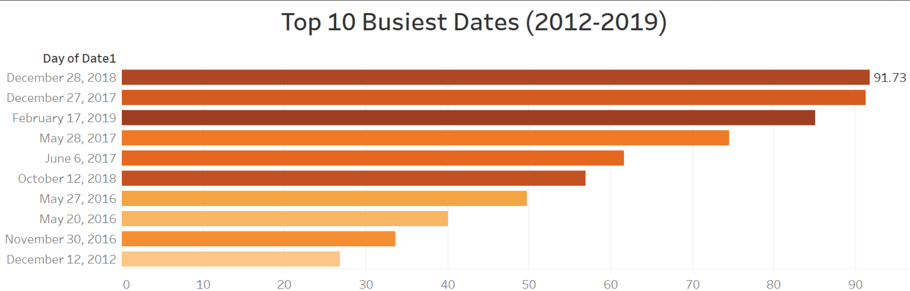
Attendance Trends and Wait Time Records
16
Notes:
Chris
Seasonal trends in wait times on the left chart. These are seasons as Disney describes it for their own analysis
On the right is the top overall busiest days for the extent of the data set. Based Trend shows that parks are becoming more popular and causing more frequent, longer wait times

Slide 17
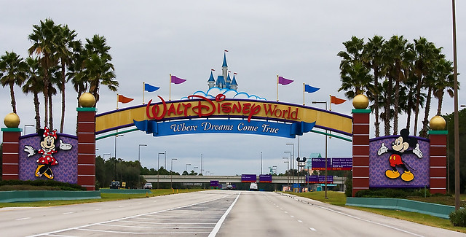
Benefits of this Research
Travel Companies
Optimize Disney vacation experience
Dates and seasons to avoid
Economic Trends
Annual cycles
Economic ebbs and flows
17
Notes:
Kevin
Research can be used by travel companies and families to help plan when to go to Disney World, what parks to do when. Goal is to maximize experience in the park
Economists could use the wait times as a measure for how the economy is doing. Disney is dependent on market strength for how overall park attendance does so seeing how the wait times are changing over time could suggest what the economy is doing as a whole.

Slide 18
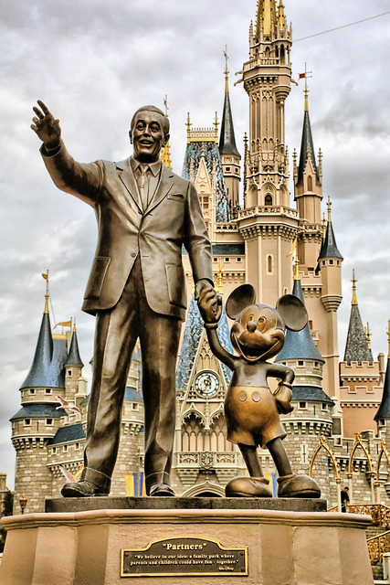
Benefits of this Research
“It can’t just be special – it has to be spectacular”
Bob Chapek
Disney’s Analysis
Price increases justified (business perspective)
People willing to pay and wait for rides
Where to focus finances
Future changes to rides and other park features
Mindful of relevance not sentimentality
18
Notes:
Kevin
Disney can use this to see that as attendance and wait times increase, regardless of the price they are charging, that the price increases are justified so long as parkgoer experience does not waiver
Can be used to see what changes need to be made to the parks and the Disney property as a whole. Disney needs to look beyond the sentimental value and the memories that their attractions and properties make and rather look at the numbers to make their decisions. The park and the parkgoers are an ever changing demographic and Disney needs to stay relevant

Slide 19
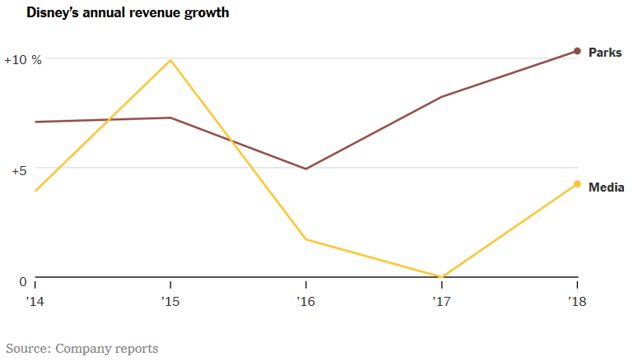
Our Suggestions
Avoid Disney World during:
School holidays and Peak Christmas time
Change or close:
EPCOT’s Spaceship Earth and Soarin’
Continue to invest in the Parks
$24 Billion from 2018 - 2023
19
Notes:
Kevin
To Disney consumers we recommend avoiding Disney when school is on vacation, or during Peak Christmas time as those experience the longest wait times on average
Disney needs to change the rides of EPCOT or at least update them. Park is the “weakest” of the Disney World parks and needs to be adjusted
Continue to invest in the parks as most important revenue generator for the company
Have 6 parks across the world along with resorts and cruise ships to create and keep up to date for their consumers

Slide 20
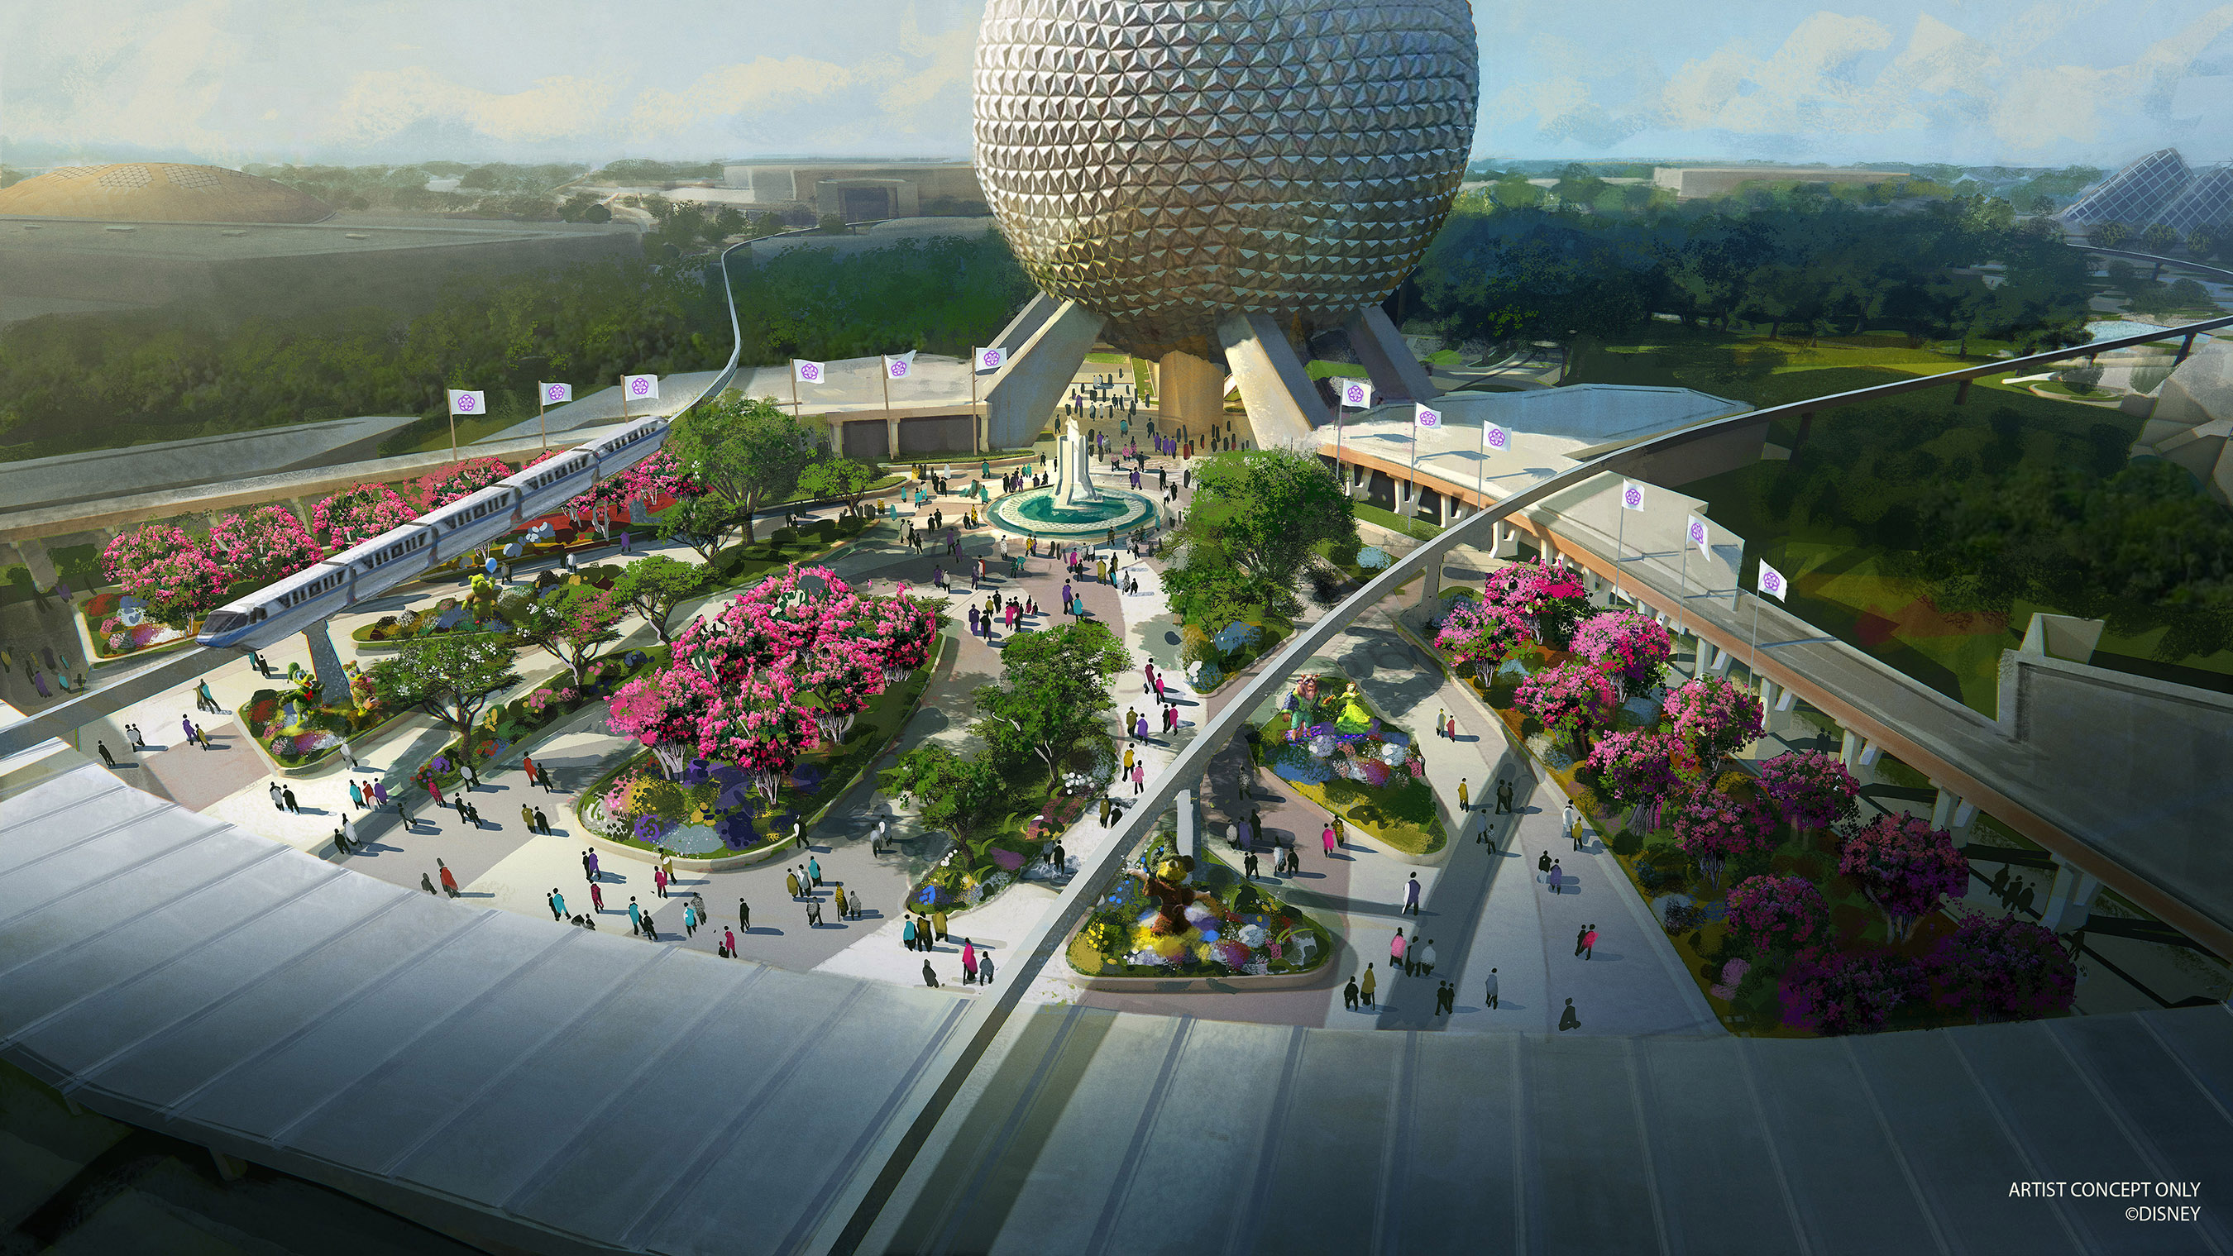
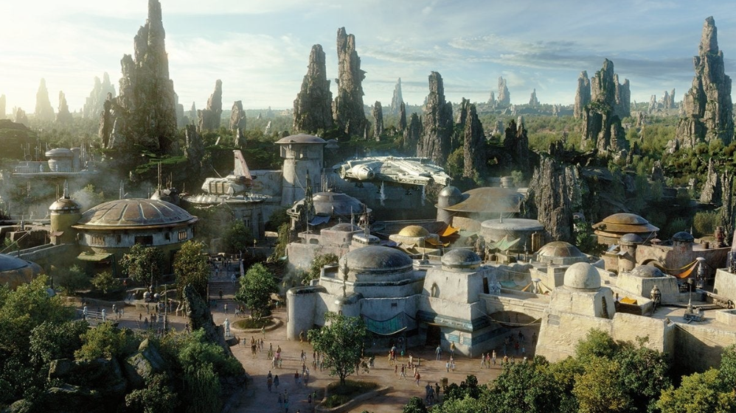
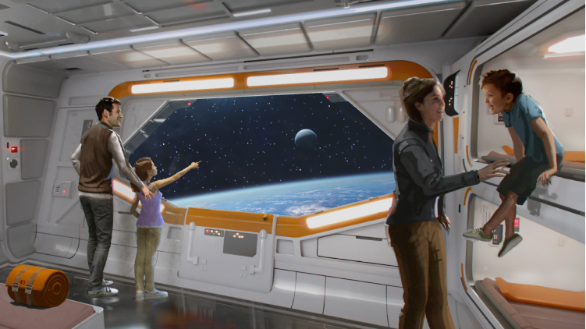
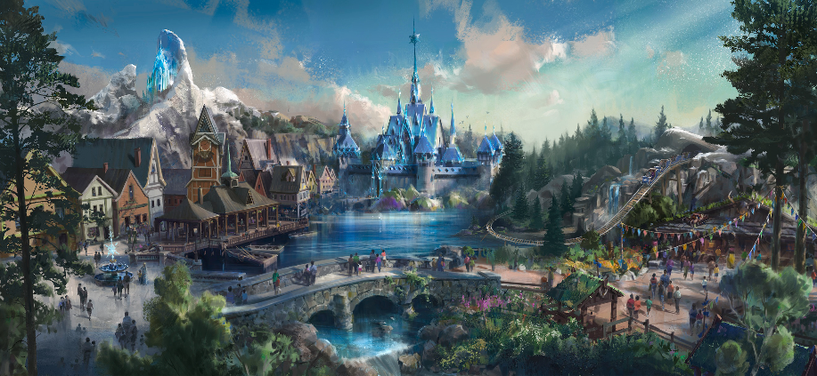
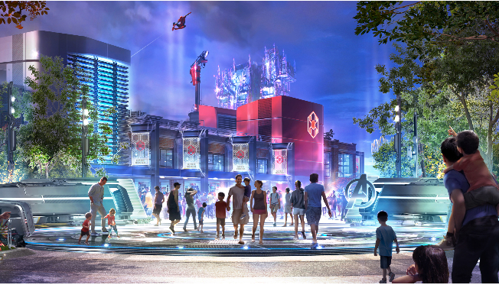
20
Notes:
Kevin
Changes Disney has in the works right now
CLOCKWISE FROM TOP LEFT
EPCOT changing World Showcase and introducing rides
Star Wars resort – windowless resort that gives a virtual reality experience of traversing the galaxy on a star wars transport vehicle
Star Wars Galaxy Edge creates the world of a trade plant with 2 new attractions in both Disneyland and Disney world
California Adventure is bringing the Marvel universe to life
$5billion facelift to Hong Kong with the kingdom of Arandelle and a total of 4 new rides being built into the park

Slide 21
Project Experience
Easiest Components:
Data Cleansing
Metadata Descriptions
Connecting Tables
Hardest Components:
Tableau Visualizations
Querying Tables
Dates in Alteryx
What we learned:
Despite the popularity
of “Flight of Passage”
other Animal Kingdom
attractions have increased in wait time
What we would change:
Utilize park
attendance numbers
Make sure our “read in” files are all the same prior to entering Alteryx
21
Notes:
Kevin
Easiest was how organized data already was, struggled getting used to tableau at first
Assumed DINOSAUR and other animal kingdom rides would have decreased wait times since Flight of Passage but that is not the case
Would love to work with official Disney numbers rather than 3rd party source but proprietary information and not available to the public

